Slide 1
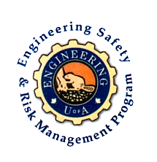
On Becoming a Leader in Risk Management
Fundamentals of RM
RM System and Process
Leadership in RM
Incident Investigation
RM Tools & Challenges
RM in Industry
People & Org.
Application & Perspectives
ENGG404 – Lecture
Case 2:
Piper Alpha Rig, Occidental Petroleum, North Sea, UK, (July 6, 1988)
1
Notes:
ENGG404 Lecture 00 - Day 1
2012 Fall
1
1

Slide 2
Learning Outcomes:
Critique of management leadership (or lack thereof) in an industrial facility / operation.
Argue in favour of the need for management leadership, commitment, and accountability at all levels, and the underlying values for what drives those needs.
Case 2 : Piper Alpha
2
Notes:
2

Slide 3
Introduction:
The case study of the Piper Alpha loss incident examines the underlying values & priorities of an organization, and how this influenced leadership commitment, employee commitment, and employees’ work practices - with tragic consequences.
Without sound leadership … the control of risks breaks down and unacceptable events will happen.
Terminology:
“PTW”
“OIM”
“PSV”
“ECC”
Case 2 : Piper Alpha
3
Notes:
3

Slide 4
Lessons of the Case Study of this Loss Incident:
…examines the underlying values & priorities of an organization, …
As leaders, we can prevent loss incidents, stop impacts on PEAP – prevent fatalities, injuries, pain and suffering
If we fail to hold the safety of the public and workers as paramount, we become responsible for the resulting pain and suffering from these incidents.
Case 2 : Piper Alpha
4
Notes:
4

Slide 5
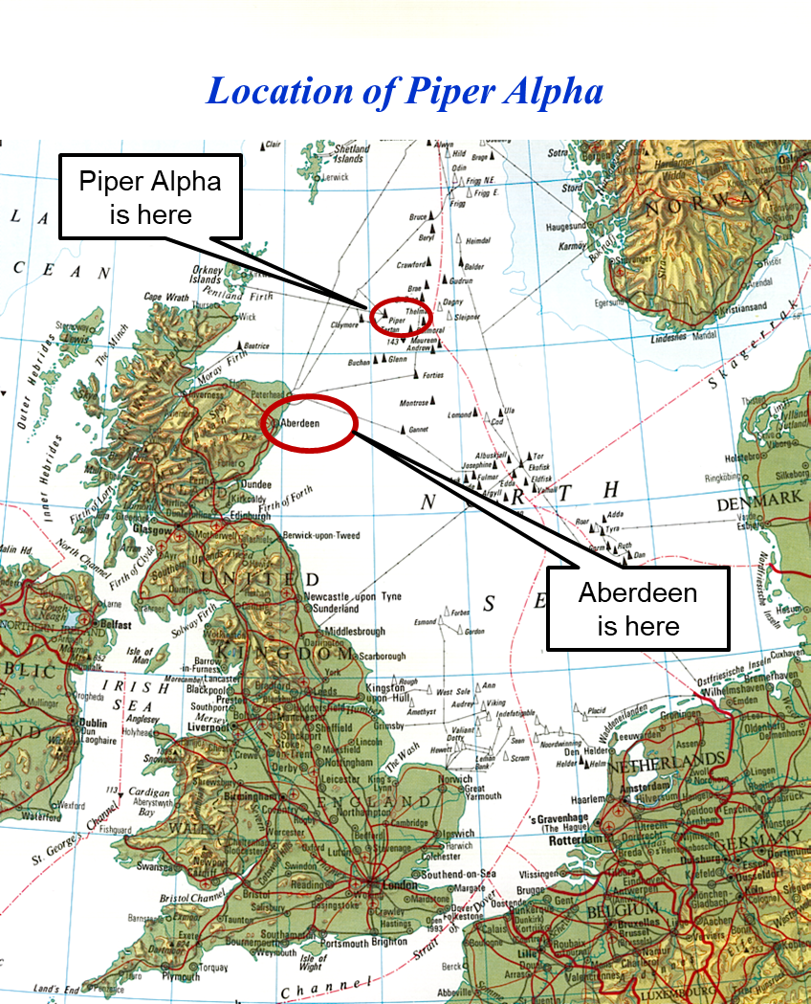
Background:
The Energy (Oil) Crisis of the early 1970s
Reliance & Vulnerability of Countries
Piper Alpha field was discovered in 1973 – considerable economic driver to the UK Economy
1970’s Corporate Culture … “How we do work around here.”
Case 2 : Piper Alpha
5
Notes:
5

Slide 6
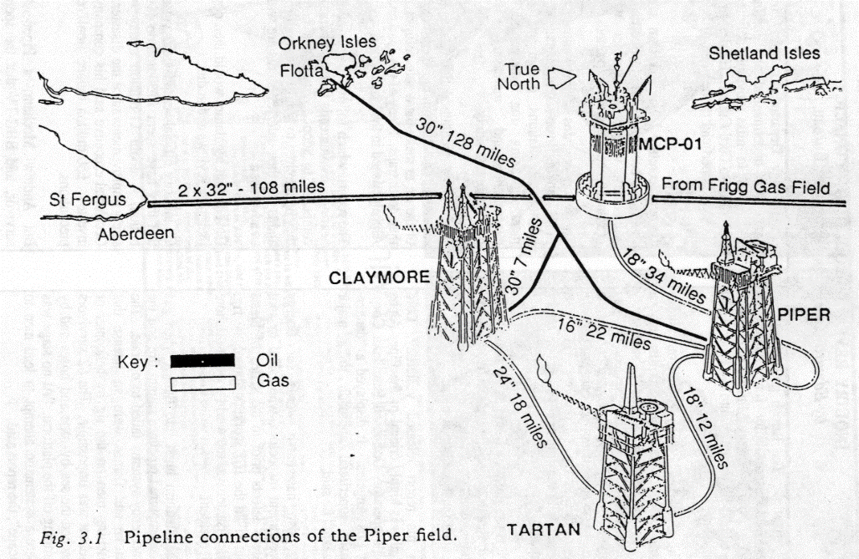
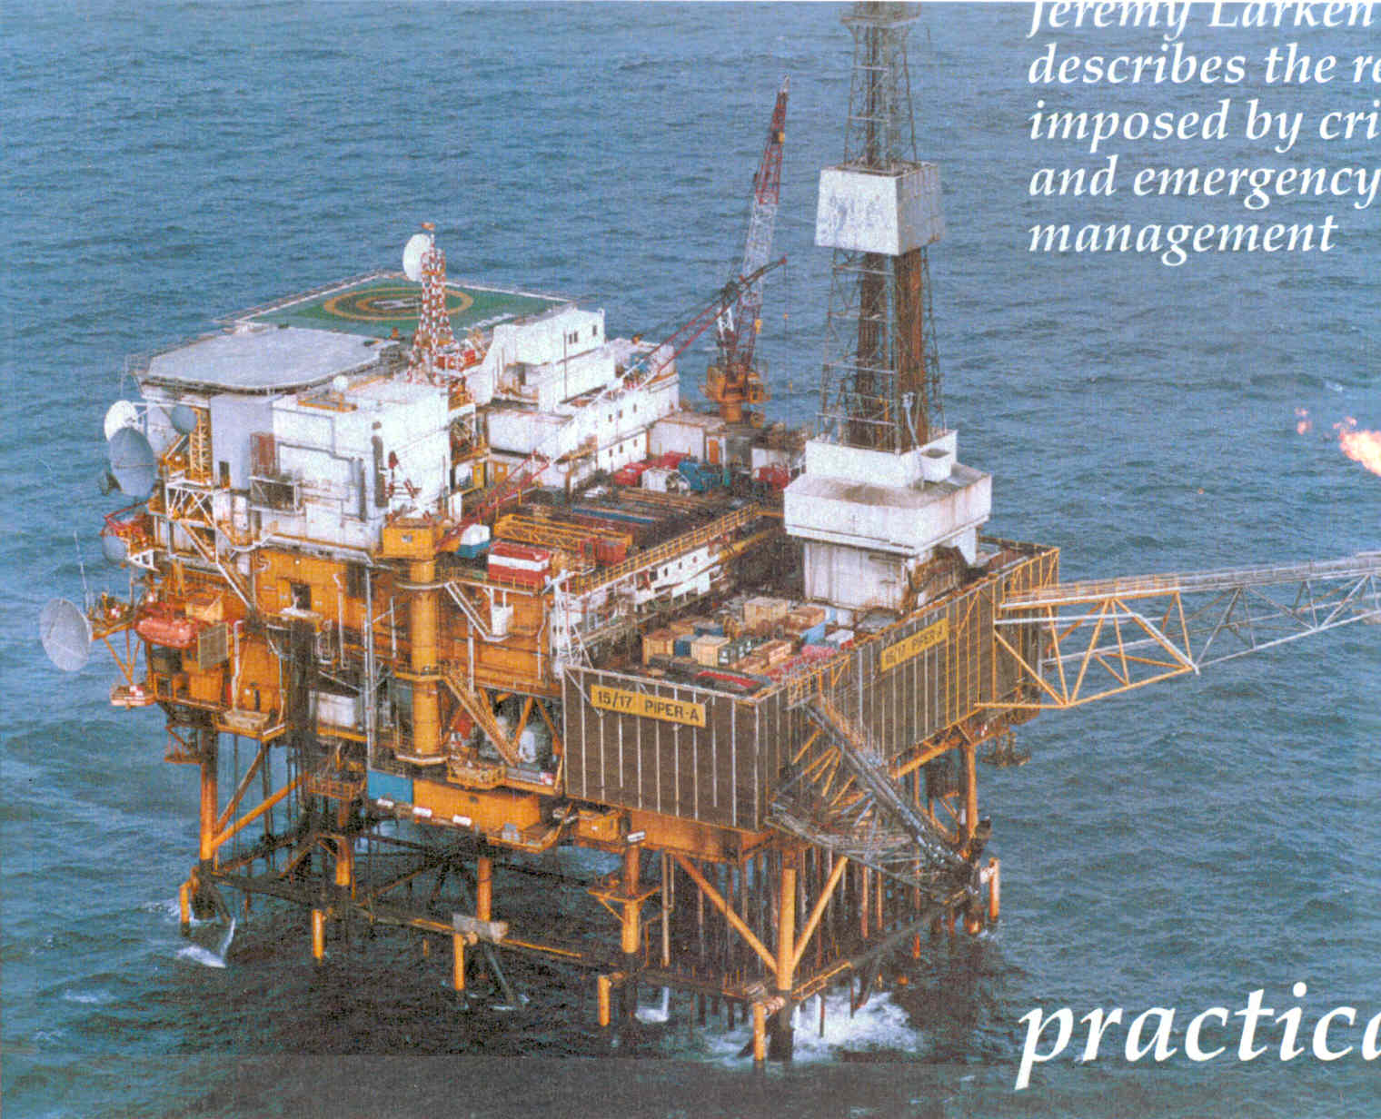
Piper Alpha Before 1988 Incident
Case 2 : Piper Alpha
6
Notes:
6

Slide 7
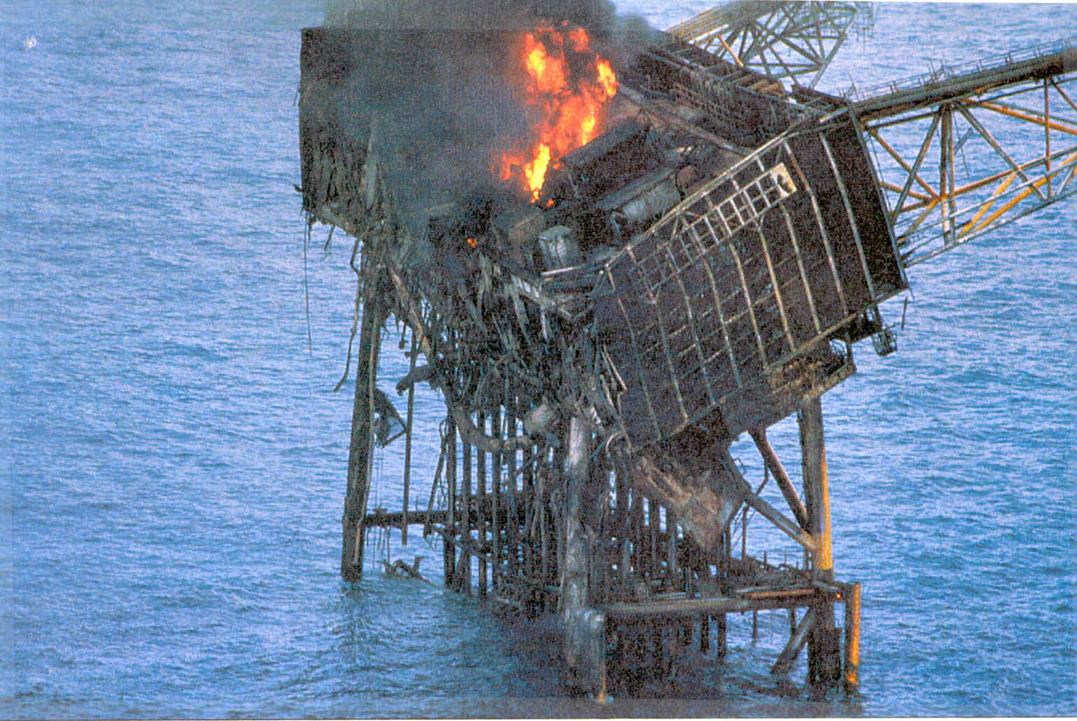
Piper Alpha Rig Disaster – part way through 1988 Incident
Case 2 : Piper Alpha
7
Notes:
7

Slide 8
Key Incident Factors
Inadequate risk assessment for fire-walls vs fire/blast rated walls
Lack of fire water availability (automatic deluge pumps switched to manual)
Inadequate mechanical integrity when PSV was removed
Inadequate management of PTW at end-of-shift hand-over
Unplanned gas compressor trip and rush to return off-line pump to service
Initial gas release and explosion (blank was sub-standard)
Lost emergency shut-down capability (switch room not protected by fire-walls)
Prolonged oil fire (lack of isolation of oil production lines)
Gas pipe failure (flame impingement, inadequate explosion walls)
Death in the “safe-haven” accommodations (positive pressure design but lack of emergency escape drills)
Inadequate escape plans from off-shore platform
Fire fighting only from one boat
No command & control during emergency
Decisions hampered - authority of Offshore Installation Manager (OIM)
Inadequate subsea isolation valve (SSIV on export lines)
Case 2 : Piper Alpha
8
Notes:
8

Slide 9
Impact on PEAP:
People: | 167 workers killed, dozens injured
Environment: | Unknown total impact. Hydrocarbons (crude oil and fuel) and products of combustion were released to the marine environment
Assets: | Lost; no salvageable assets
Production: | Lost; no salvageable production capability (150,000 bbl/d oil, 1 billion litres per day natural gas) Fire disrupted productivity of other rigs
Video
Case 2 : Piper Alpha
9

Slide 10
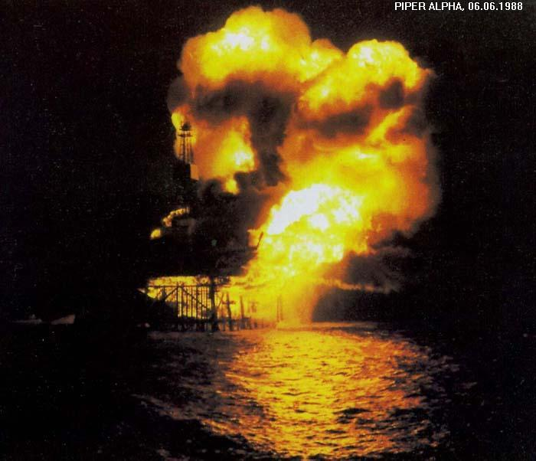
1.5X UK consumption rate at 3 tonnes / second over 75 metres square … an incredible heat flux!
The findings of The Lord Cullen Public Inquiry (the investigation report) changed the game for off-shore platforms in the industry …with the goal to prevent loss incidents!
Piper Alpha Oil Rig Fire 1988
Case 2 : Piper Alpha
10
Notes:
10

Slide 11
Piper Alpha: Management System Opportunities
RME #1: Management Leadership, Commitment, and Accountability
Corporate Safety Culture: Leadership influences and drives culture; values and actions define the culture. Both a good culture and sound risk management program are necessary for sustainable performance.
Case 2 : Piper Alpha
11
Notes:
11

Slide 12
Piper Alpha: Management System Opportunities
RME #2: Risk Assessment and Management of Risks:
All organizations require the upfront / initial and on-going, continuing need for risk assessments and management of risks.
Administrative Controls: Life-critical safe work practices (PTW, Lock-out) must not be allowed to degrade. These practices keep things on-track. Just because nothing has happened does not mean one can relax the work practices. Critical decisions were not being managed by those directly controlling the risks (OIM).
Engineering Controls: Critical safety devices were rendered ineffective (the PSV without being replaced with an appropriately pressure-rated fitting), or bypassed (the fire protection deluge system), or design recommendations were not ineffectively installed (blast-proof walls and system back-flow shut-off).
Case 2 : Piper Alpha
12
Notes:
12

Slide 13
Piper Alpha: Management System Opportunities
RME #6: Auditing (Program Evaluation and Continuous Improvement):
The case study demonstrated several examples where stringent engineering controls and administrative controls slowly degraded to the point of being ineffective.
Auditing: Managers must check on the “health” of the management system i.e. inspect for compliance, and take action to address deviations. Auditing is a key and fundamental management process.
What would have been the outcome had management discovered and taken action to “tighten” the discipline around managing the PTW process and the work permitted?
Case 2 : Piper Alpha
13
Notes:
13

Slide 14
Summary & Key Lessons
Values and priorities heavily influence our decisions – sometimes with grave consequences
“Without sound leadership … the control of risks breaks down and unacceptable events will happen.” ☞ Management Leadership …
Do you think there were “signals” that would have reflected the condition of the safety program on Piper Alpha before the incident? ☞ Risk Assessment …
Do we only hear “good” news? Are we out there (manager’s boots on the ground) finding out what is really happening? ☞ Program Evaluation … (auditing)
Case 2 : Piper Alpha
14
Notes:
14

